Slide 1
TECHNICAL PRESENTATION
•
5–7 Min Duration
Debugging 101: Surviving Real-World Errors
From Frustration to Fix
SPEAKER
HTML / CSS
JavaScript
React.js
Web Architecture & Engineering

Slide 2
Slide 02 / Mindset
50%
The Reality Check — Errors Happen to Everyone
DEV TIME ON DEBUGGING
"Bugs are just undocumented features waiting to be fixed."
Errors are normal engineering signals, not signs of developer failure.
EMOTIONAL REACTION PROGRESSION
STAGE 01
STAGE 02
STAGE 03
Panic
Confusion
Acceptance
Red screens & stack traces feel terrifying to beginners.
Questioning code logic and searching for fault origins.
Reading exceptions as clues to systematically isolate bugs.

Slide 3
Slide 03 / Pitfalls
Common Culprits across HTML, CSS, JS & React
HTML & CSS
JavaScript
React.js
LAYOUT & SYNTAX TRAPS
ASYNC & REFERENCE FAULTS
STATE & LIFECYCLE VIOLATIONS
• Unclosed tags breaking DOM structures
• Cannot read properties of undefined
• Infinite render loops via unguarded setState
• Specificity wars overriding target styles
• Reading API responses prior to fetch resolve
• Rules of Hooks conditional calls
• Overflow and flex/grid layout collapses
• TypeError: fn is not a function
• Stale state closures inside useEffect
Uncaught TypeError: user.name is undefined
<div class="card"> <!-- Unclosed -->
Too many re-renders. Exceeded max depth.

Slide 4

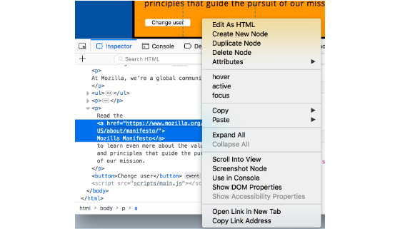
Slide 04 / Strategy
My Go-To Debugging Toolkit & Strategy
a. Read Console
b. Strategic Logs
Target stack trace line numbers and read top-to-bottom.
Inspect variable states at specific execution moments.
c. Elements Tab
d. React DevTools
Toggle CSS rules and inspect active DOM tree hierarchy live.
Verify real-time component props and state trees.

Slide 5
SLIDE 05 / CONCLUSION
Turning Bugs into Lessons
Debugging isn’t a roadblock—it’s the fastest way to learn. Every solved bug builds a deeper understanding of web engines.
Embrace Exceptions as Clues
Thank You! Questions & Discussion
"What is the most annoying bug you’ve ever had to solve?"

